Slide 1
Data Videos / Curve Fitting
Primary Purposes
Create more powerful visualizations
Solving a computer vision problem: shape of a meteorite
Learn how to use/enhance 3rd party Python code
Goals
Understand main features of the code
Run the code on your laptop, replicate results
Understand when such videos are useful
Produce your own data videos in Python

Slide 2
Data Videos / Curve Fitting
250 training sets (20 per second)

Slide 3
Data Videos / Curve Fitting
Key concepts related to the video
Synthetic data / generative models
Confidence regions
Rich versus poor synthetic data
Bias in black-box systems

Slide 4
Data Videos / Curve Fitting
Key concepts (continued)
Proxy estimators
Model-free estimation
Unsupervised & simplified regression
Learn how to learn
Sampling points on an ellipse: how to find Python code
How could this be used for linear or polynomial regression?

Slide 5
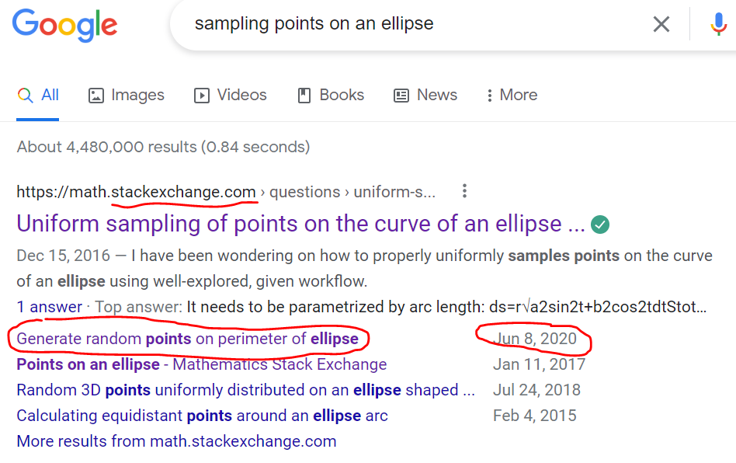
Data Videos / Curve Fitting

Slide 6
Data Videos / Curve Fitting
Search results
Sampling points on an ellipse: right versus wrong way

Slide 7
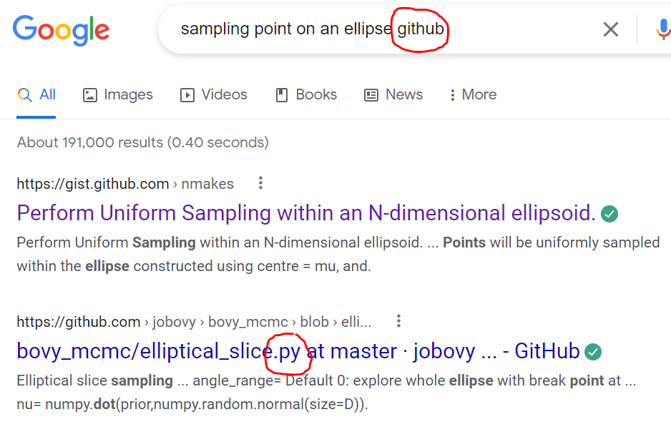
Data Videos / Curve Fitting

Slide 8
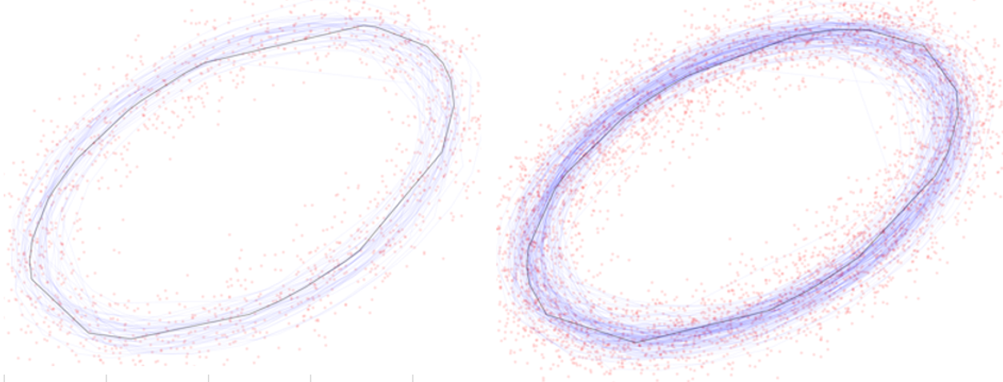
Data Videos / Curve Fitting
Sample output from Python code: shape of a meteorite
Goal: create a taxonomy of meteorites
Picture shows confidence regions for a specific shape

Slide 9
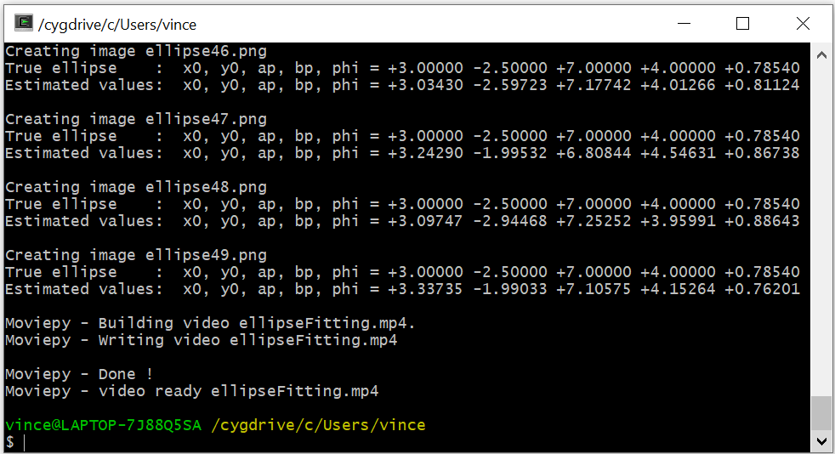
Data Videos / Curve Fitting
Text output from Python code

Slide 10
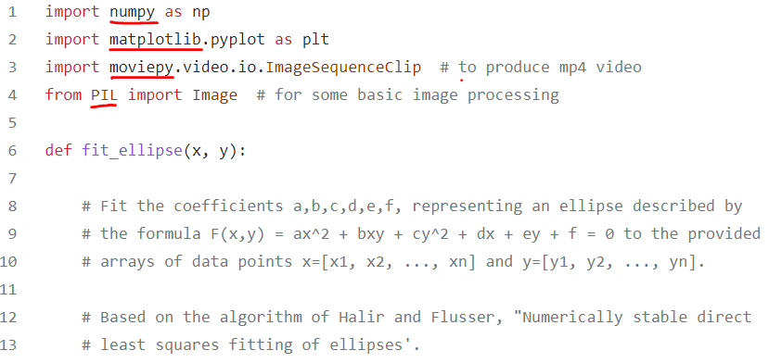
Data Videos / Curve Fitting
Full source code (299 lines): https://mltblog.com/3rl4KDs

Slide 11
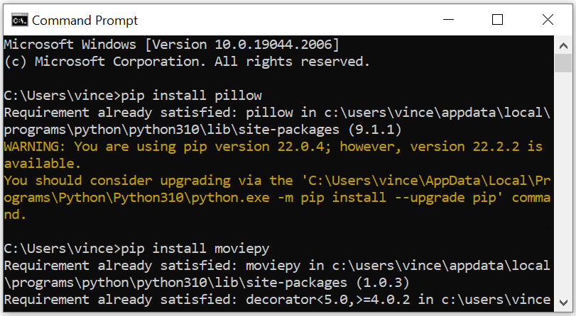
Data Videos / Curve Fitting
Choosing and installing Python video/image libraries
Open command prompt windows, then

